Slide 1
Determining the Irreducible Elements of an Interim Agreement with Iran:
A Freeze Plus
David Albright
ISIS
November 5, 2013

Slide 2
The Key Nuclear Sites at Issue in an Interim Agreement

Slide 3
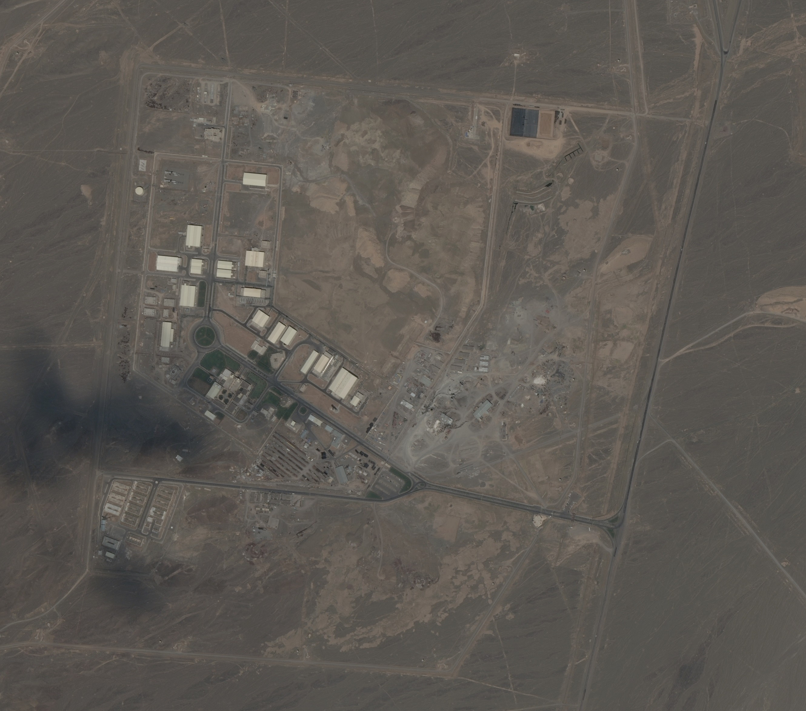
Photo of Natanz, DigitalGlobe

Slide 4
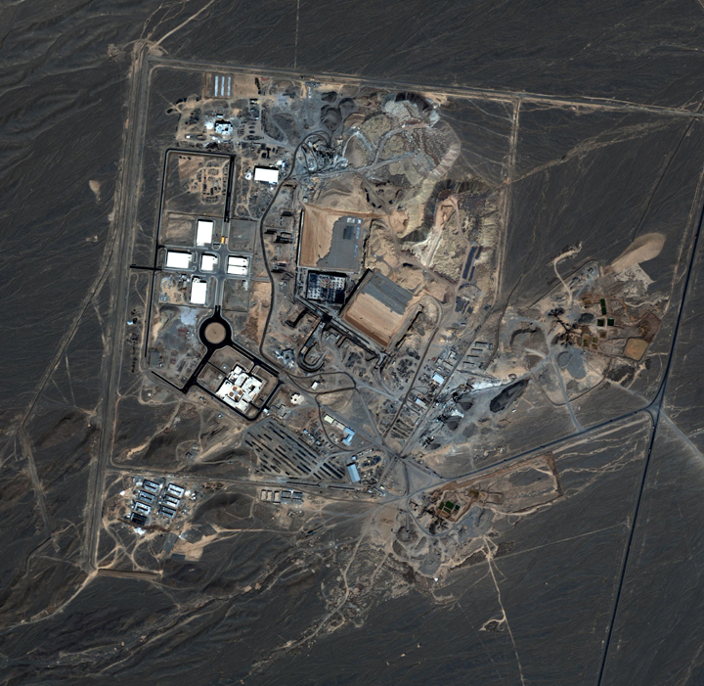
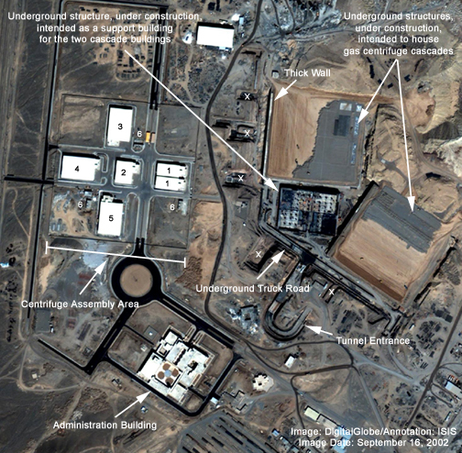
Natanz Plant, September 2002, showing its underground structure, Digital Globe Images

Slide 5
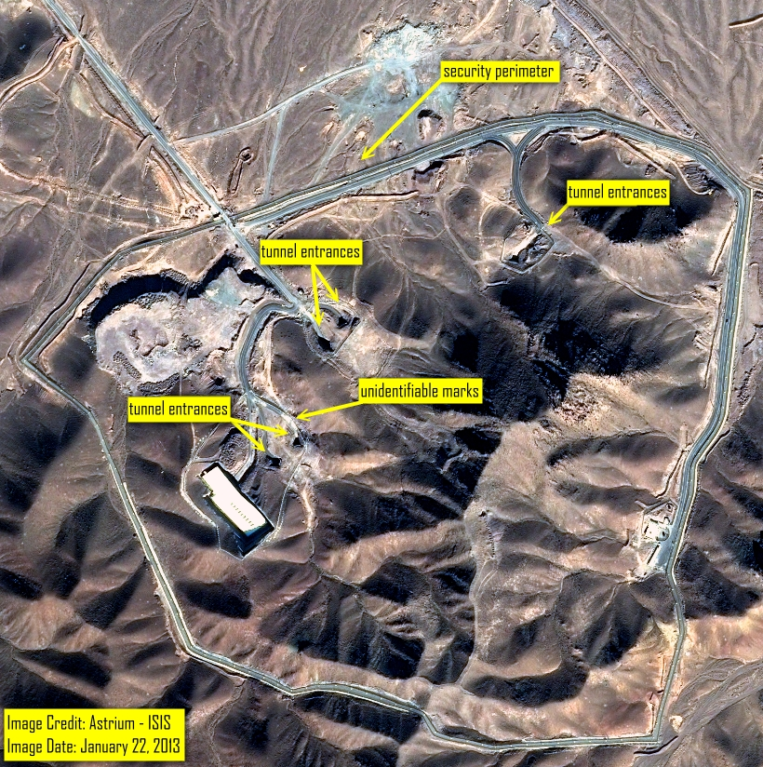
Fordow Centrifuge Facility

Slide 6
Arak Heavy Water (IR-40) Reactor

Slide 7
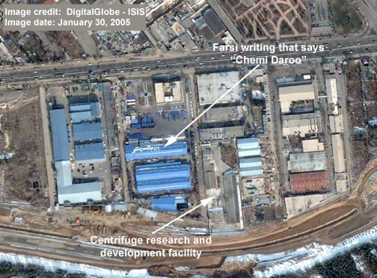
Kalaye Electric Facility, Centrifuge R&D

Slide 8
Status of Iran’s Declared Centrifuge Program

Slide 12
Cumulative 3.5% LEU Production

Slide 14
Taking Stock, August 2013
LOCATION 3.5% LEU product 3.5% LEU feed 19.75% LEU product
FEP 9,704 kg N/A N/A
PFEP N/A 1,455 kg 178 kg
FFEP N/A 1,422 kg 195 kg
GROSS TOTAL 9,704 kg 2,877 kg 373 kg
NET TOTAL 6,774 kg* 2,877 kg 186 kg (in hex form)**

Slide 15
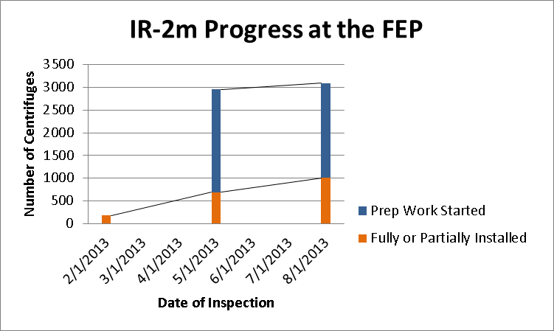
Advanced Centrifuge Deployment: Natanz Fuel Enrichment Plant (FEP)

Slide 16
Timelines for a Breakout to Enough Weapon-Grade Uranium for a Nuclear Weapon at Declared Enrichment Sites

Slide 17
Estimating Breakout Timelines
Illustrative IR-1 centrifuge plant to make weapon-grade uranium (WGU), based on a four Step, Khan-Type Centrifuge Plant
24 cascades (164 P1s/cascade) make 3.5% LEU--3,936 P1s
8 cascades (164/cascade) make 20% from 3.5%--1,312 P1s
4 cascades (114/cascade) 20 to 60%--456 P1s
2 cascades (64/cascade) 60 to 90%--128 P1s
  Total: 38 cascades with 5,832 P1s
  Iranian cascades are not ideal and their performance and output is modeled by Houston Wood and Patrick Migliorini from University of Virginia’s Mechanical & Aerospace Engineering Department in collaboration with ISIS.

Slide 18
Production of WGU in a Breakout at Declared Enrichment Sites
2009 Nuclear weapons capability achieved in that Iran has enough IR-1 centrifuges and 3.5 percent LEU (about 1,500 kg 3.5 LEU hexafluoride to produce 25 kg weapon-grade uranium in a breakout in about 4,593 enriching IR-1 centrifuges. Breakout would take longer than six months
August 2012-breakout time using Natanz only (IR-1 centrifuges being installed in Fordow) was 2.5-4.1 months with three-step process, 9,330 IR-1 centrifuges, a stock of 91 kg near 20 percent LEU hexafluoride, and use of 3.5 percent LEU hexafluoride (in three-step process)
August 2013-Breakout time with enriching IR-1 centrifuges only is 1.3-2.3 months, with three step process with 10,092 IR-1 centrifuges, 186 kg near 20 percent LEU hexafluoride, and use of 3.5 percent LEU hexafluoride. [3.1-3.5 months with 3.5 percent LEU only, no near 20 percent LEU]
August 2013-Breakout time for scenario using all installed IR-1 centrifuges is 1.0 to 1.6 months with three step process as above but with 18,454 IR-1 installed centrifuges and 186 kg near 20 percent LEU hexafluoride. [1-9-2.2 months with 3.5% LEU only and no near 20% LEU]
Note: calculational methods changed somewhat from Fall 2012 estimates to fall 2013 estimates

Slide 19
Key Goals for Negotiations
Stopping the advance of Iran’s centrifuge and Arak reactor programs
Extending breakout times
Capping the Iranian centrifuge program and ensuring that it will not expand beyond this cap (in terms of enrichment output) during the next 5-15 years.
Ensuring that Iran is not building another centrifuge plant and increasing the chance of finding a secret centrifuge or plutonium separation plant. How to establish adequate transparency in general, including Iran addressing the IAEA’s concerns about Iran’s past and possibly on-going nuclear weapons efforts?
How to trade Iranian concessions for sanctions relief? In the longer term, what incentives package is appropriate and how to increase Iran’s supply of medical isotopes and nuclear electricity? These questions, while vital, are not addressed here.
The United States anticipates obtaining an interim agreement followed several months later by a long-term agreement that will verifiably ensure that Iran will not build nuclear weapons.
What are minimal conditions to look for in an interim deal?

Slide 20
Minimal Goals of an Interim Agreement: Freeze Plus
Freezing the centrifuge program and extending breakout times:
  Stopping production of near 20 percent LEU; mothballing or disabling the six cascades involved in making near 20 percent LEU at Natanz and Fordow
  Reducing stocks of near 20 percent LEU, focusing initially on a time table to eliminate all stocks in hexafluoride form through shipping out of country, blending down, or converting into oxide form. (A longer-term agreement would need to eliminate all stocks of near 20 percent LEU, other those that are irradiated or about to be loaded into a reactor)
  Achieving the principle that Iran’s centrifuge program would be capped to below a certain size, taken initially as about 9,000 enriching IR-1 centrifuges in only three modules at the Natanz Fuel Enrichment Plant, a slight decrease from the current level of enriching centrifuges. Other modules at Natanz and those at Fordow would be disabled, so as to increase the time needed for restart
  Halting the installation of any more centrifuges. The issue of whether the IR-2m centrifuges, or other advanced centrifuges, would enrich uranium would be addressed later, although in a way that is consistent in terms of maintaining the cap in enrichment output stated in the third sub-bullet.
  Spares for broken IR-1 centrifuges could come from the large inventory of IR-1 centrifuges installed at Natanz and Fordow but not yet enriching (about 8,000 as of August 2013). As a result, Iran would have no need to manufacture more IR-1 centrifuges for years, allowing for the freezing of centrifuge manufacturing immediately and thereby easing the verification task that Iran does not have any covert centrifuge plants (see also below).
  Establishing remote camera monitoring at the centrifuge plants. Alternatively, inspectors could visit these sites daily, or near daily, although this step would require substantial IAEA inspector resources which could be better applied to other tasks in Iran.

Slide 21
Freeze Plus (cont.)
Halting further construction of the Arak reactor, including the manufacturing of its fuel
Preliminary steps aimed at helping ensure Iran is not building another centrifuge plant and increasing the chance of detecting a secret centrifuge plant:
  Implementation of early notification of construction of new facilities (code 3.1 of comprehensive safeguards agreement)
  Developing a baseline of information about Iran’s gas centrifuge program, including a detailed declaration of any centrifuge plants under construction or planned for construction; a declaration of its centrifuge research, development, assembly and manufacturing complex; and a declaration of Iran’s total inventory of centrifuges.
  Other verification measures, such as the Additional Protocol and the monitoring of uranium mines and mills and of the centrifuge complex, would be implemented later.
Ensuring that Iran agrees that future sanctions relief requires that Iran address fully and cooperatively the IAEA’s concerns about Iran’s alleged past and possibly on-going work on nuclear weapons.

Slide 22
Final Comment
Achieving the above conditions in an interim agreement would address the most pressing issues involving breakout timelines and undeclared centrifuge programs.
These conditions would allow time for negotiating a longer term agreement that would comprehensively ensure that Iran will not build nuclear weapons.
In essence these conditions amount to a freeze in Iran’s centrifuge and Arak reactor programs plus small reductions in the scale of the centrifuge program, some modest declarations, and a few additional transparency and disablement steps.
A longer term agreement would need to include far more detailed conditions on the scope and timing of Iran’s nuclear program, far more intrusive inspection arrangements, and much more detailed declarations about Iran’s nuclear programs.

