Slide 1
On the Question of Another North Korean Centrifuge Plant and the Suspect Kangsong Plant
David Albright
Institute for Science and International Security
May 25, 2018

Slide 2
Summary: Suspect Kangsong Enrichment Plant
We have learned of a suspect gas centrifuge site, in addition to the one at the Yongbyon Nuclear Center, that has the name of Kangsong. It may have other names as well.
We have not located this site, although we received a description of the building from more than two independent governmental sources. Its operation allegedly started several years ago.
If it is a centrifuge plant, we are unaware of any information on how well it has operated.
The original information about this site came from a defector several years ago who stated he worked near this site. Defector information must be confirmed. However, we have received the names of other alleged centrifuge sites that we viewed as less credible than the information about Kangsong. Moreover, this site appears to have received greater foreign governmental scrutiny and credibility than the other sites, particularly by the United States.
The exact number of centrifuges in the secret facility is difficult to predict but we have been told that governments estimate that it could contain 6,000-12,000 P2 centrifuges, the type seen in the Yongbyon centrifuge plant in 2010, when a group of Americans briefly visited this facility.
An early centrifuge plant can have substantial operational difficulties. Although we accept the governmental estimates, based on the size of the plant and procurement information, in our assessments, we treat the plant as having operated, on average, several thousand centrifuges for several years.
Not all government analysts agree that it is a centrifuge site. Although there appears to be more information than just a defector report, some aspects of the building are not consistent with a centrifuge plant, leading senior officials in at least one government to not believing this facility is a centrifuge plant.

Slide 3
Summary (cont.)
We continue to treat this facility as an unconfirmed centrifuge plant in our own estimates of North Korea’s production of weapon-grade uranium and nuclear weapons but increasingly believe that this is a credible location of a secret centrifuge plant.
It is important to confirm that Kangsong is a production-scale centrifuge plant and to learn if any others exist. There has been some speculation, albeit weakly supported, that North Korea has a total of three centrifuge plants.
A priority in any negotiations is for North Korea to reveal its entire enrichment program and allow verification of revelations and declarations. It should also be pointed out that unless North Korea reveals its entire centrifuge complex, and allows verification of any declaration, any denuclearization agreement will likely be unachievable.

Slide 4
Evidence for another Centrifuge Plant: Background

Slide 5
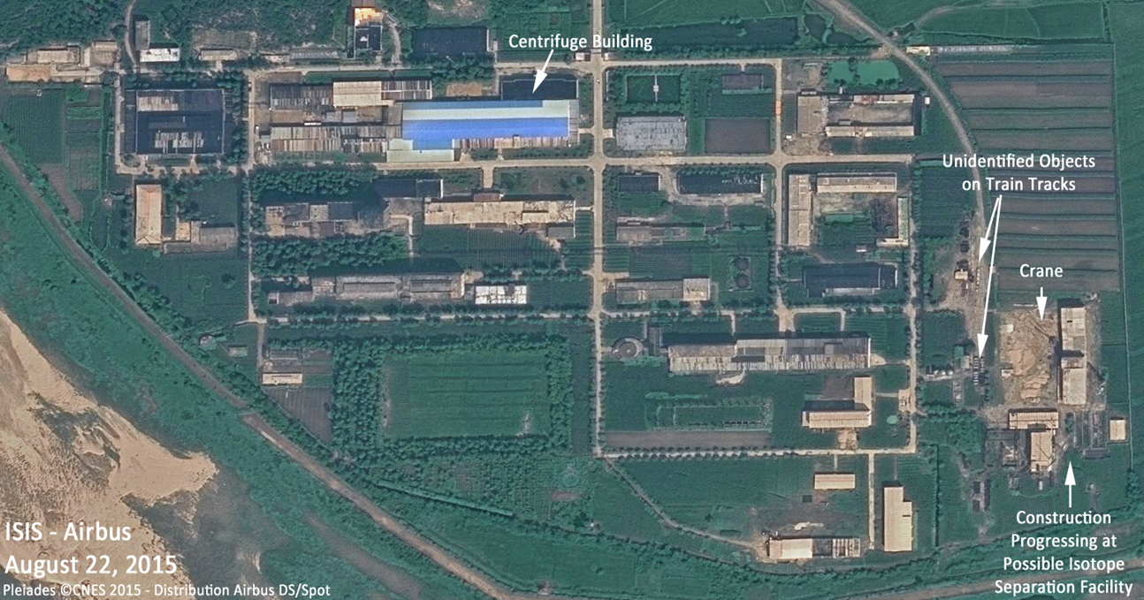
Is the Yongbyon centrifuge site the only one?
This question has been central and controversial since North Korea revealed the existence of the Yongbyon centrifuge plant in 2010 to a group of visiting Americans.
Even before the 2010 revelation, some believed that there was a centrifuge plant outside Yongbyon.

Slide 6
Yongbyon Centrifuge Plant
The Yongbyon site was built relatively quickly.
According to a defector from Yongbyon, this facility has only a small centrifuge assembly hall, operated under clean room conditions, where pre-assembled parts are received and assembled into final centrifuge components. The defector said he was involved in creating the initial centrifuge assembly hall for this plant and had no prior experience assembling centrifuges before the first deliveries of parts.
His statement suggests, but by no means proves, that there could be another centrifuge plant and that the Yongbyon facility was built subsequent to the other, secret one.

Slide 7
Doubts about another centrifuge plant
The lack of concrete evidence of an earlier plant at the time led to doubts about its existence.
Moreover, there have been plausible explanations that the Yongbyon centrifuge plant is North Korea’s only operating production-scale plant.
  North Korea could have suffered delays caused by the difficulty of building and operating centrifuges.
  These difficulties would have been compounded by the unexpected busting of the notorious A.Q. Khan network in 2003 and 2004, a network that North Korea may have needed to provide substantial on-going centrifuge assistance.

Slide 8
However, other evidence exists for another plant
The evidence for another, earlier enrichment plant, based on gas centrifuges, is substantial but controversial.
This other centrifuge plant could have started operation as early as the mid-2000s.
This plant could have made a substantial amount of weapon-grade uranium, complicating further efforts to dismantle and verify denuclearization.

Slide 9
Argument for: Weapon-grade uranium detected in North Korea
Weapon grade uranium was found on materials the United States brought out of North Korea in 2006 and 2007 as part of verification under the Six Party Talks.
U.S. intelligence agencies assessed that this weapon-grade uranium was made in North Korea at a production-scale plant.
This assessment was not unanimous in the U.S. intelligence community, however.
Accepting this assessment implies that North Korea could have been operating a production-scale centrifuge plant by the mid-2000s.

Slide 10
Argument for: Procurement Information
Procurement information provides another compelling rationale to believe that the Yongbyon centrifuge plant is not the first one.
Western countries track North Korea’s procurements for its centrifuge program closely and have spotted several peaks in procurements for the centrifuge program.
Procurements have been extensive and have followed the types of procurements done by A.Q. Khan for Pakistan’s centrifuge program.

Slide 11
Chronology of Detected Procurements Related to Centrifuge Plants
2002/2003: procurements sufficient for about 8,000-12,000 P2-type centrifuges
Between 2003 and 2008: many procurements for centrifuge program
2008: procurements sufficient for 2,000 P2 centrifuges
End 2010: procurements for extension of the Yongbyon centrifuge plant. Procurements sufficient for 500-1000 centrifuges
Early 2016: procurements detected sufficient for one low enriched uranium (LEU) cascade

Slide 12
Secret Centrifuge Plant?
Would North Korea procure so much in the early 2000s and not build a centrifuge plant? Why would it wait until the late 2000s to build one at Yongbyon, ostensibly related at the time of its public declaration in 2010 only to the production of low enriched uranium (LEU)?
North Korea’s procurement history suggests the existence of a secret or undeclared, production-scale centrifuge plant(s) that was built in the mid-to-late 2000s.
The plant could have at least several thousand operational P2 centrifuges.
Could it have 12,000 P2 centrifuges, 6,000 P2 centrifuges? I am skeptical about the larger estimates but I cannot disprove them.
How well has it worked? That is a critical unconfirmed question.

Slide 13
Suspect Kangsong Centrifuge Plant

Slide 14
Suspect Kangsong Enrichment Plant
We have learned of a leading candidate for this other centrifuge plant with the name Kangsong. It may have other names as well.
We have not located this site, although we received a description of the centrifuge building. Its operation allegedly started several years ago.
If it is a centrifuge plant, we are unaware of any information on how well it has operated.
The original information about this site came from a defector several years ago. Defector information must be confirmed. However, we have received the names of other alleged centrifuge sites that we viewed as less credible than the information about Kangsong. Moreover, this site appears to have received greater foreign governmental scrutiny and credibility than these other sites.
The size of the site is difficult to predict but we have been told of governmental estimates that it could contain 6,000-12000 or more P2 centrifuges.
An early centrifuge plant can have substantial operational difficulties. Although we accept the governmental estimates, based on the physical size of the plant and procurement information, in our assessments, we treat the plant as having operated on average with several thousand centrifuges for several years.
Not all government analysts agree that it is a centrifuge site. Although there appears to be more information than just a defector report, some aspects of the building are not consistent with a centrifuge plant, leading to at least one government that does not believe it is a centrifuge plant.

Slide 15
Findings
We continue to treat the Kangsong facility as an unconfirmed centrifuge plant in our own estimates but increasingly believe that this is a credible location of a secret centrifuge plant.
It is important to confirm that Kangsong is a production-scale centrifuge plant and to learn if any others exist. There has been some speculation, albeit weakly supported, that North Korea has a total of three centrifuge plants.
A priority in any negotiations is for North Korea to reveal all its enrichment plants and allow verification of its revelations and declarations. It should also be pointed out that unless North Korea reveals its entire centrifuge complex, and allows verification of any declaration, any denuclearization agreement will likely be unachievable.

Slide 16
Nuclear Weapons Estimates, Assuming a Second Enrichment Plant Exists

Slide 17
Considering a Second Enrichment Plant in Estimating the Number of Nuclear Weapons
As discussed, most analysts believe a second, older enrichment plant exists and has made weapon-grade uranium for a number of years.
This is essentially an upper bound estimate, compared to earlier Institute estimates.
Based on discussions with U.S. officials, U.S. estimates of nuclear weapons capabilities assume that this second enrichment plant exists and has contributed significantly to North Korea’s stock of weapon-grade uranium.
Although I am less sure of the resulting weapon-grade uranium estimates, it is useful to focus on the case of two centrifuge plants producing weapon-grade uranium as a basis to think through verification approaches in the event of success in negotiations of North Korean denuclearization.

Slide 18
Scenario with Two Enrichment Plants
Below are frequency distributions that have translated estimates of the total amount of plutonium and weapon-grade uranium (WGU) as of the end of 2017 into an equivalent number of nuclear weapons.
These distributions rely on estimates of both plutonium and WGU that, as I have presented earlier¹, involve a range of variables, each of which is represented as a range of values with a probability attached to each value, typically a uniform distribution (equally likely to be the case).
Another variable is the amount of plutonium or WGU per weapon (a range with a probability assigned).
Each of these variables is sampled by Crystal Ball software, in most cases 5,000 times, resulting in a frequency distribution of results. The idea is that the median value of this frequency distribution is more likely but in fact the range is more representative of the actual situation.
In the frequency distribution on the next slide, the estimated number of nuclear weapons equivalent is presented, abbreviated by “Eq.”
1. Albright, “North Korea’s Nuclear Weapons Capabilities: A Fresh Look,” Institute for Science and International Security, August 9, 2017, http://isis-online.org/isis-reports/detail/north-koreas-nuclear-capabilities-a-fresh-look-power-point-slides/10 ; Albright, “Denuclearizing North Korea,” May 14, 2018, http://isis-online.org/isis-reports/detail/verified-denuclearization-of-north-korea-mechanics-and-prospects, and Albright, “Understanding North Korea’s Nuclear Weapon Capabilities,” May 14, 2018, unpublished.

Slide 19
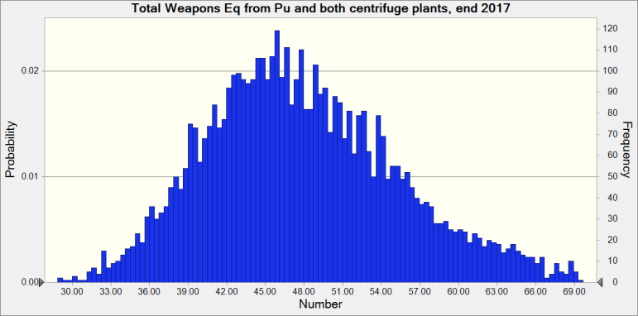
Weapons from all of the Estimated Pu plus WGU from Two Centrifuge Plants, end 2017
The median of this slightly skewed distribution is about 47 weapons equivalent, with a standard deviation of 7.8 weapons equivalent. The full range is 26 to 80 weapons’ equivalent. The 5th and 95th percentile are 37 and 62 weapons equivalent, respectively.
.

Slide 20
Estimating the Potential Size of North Korea’s Nuclear Weapons Arsenal
The actual number of nuclear weapons would be expected to be fewer in number than given by the above nuclear weapons equivalent values. A fraction of the plutonium or WGU would be tied up in the manufacturing complex that makes nuclear weapons components or would be lost during such processing. Some of this material would be expected to be held in a reserve for underground nuclear testing or new types of weapons.
In these estimates, it is assumed that only 70 percent of the total amount of plutonium or WGU is used in nuclear weapons.
Accounting for this reduction, the distribution of the estimated number of weapons made from plutonium or weapon-grade uranium from two centrifuge plants at the end of 2017 follows on the next slide.

Slide 21

Number of Weapons, accounting for fissile material losses, pipeline, reserves, end 2017
The median of this slightly skewed distribution is 33 nuclear weapons, with a standard deviation of 5.4 weapons. The full range is 18-57 weapons. The range defined from the 5th and 95th percentiles of this distribution is 26 to 44 nuclear weapons.

Slide 22
Observations
These ranges for the scenario of two enrichment plants are relatively broad, about 26-44 nuclear weapons, where I use the 5th and 95th percentiles of the distribution.
These upper bounds are consistent with media reports in 2017 about U.S. government intelligence community estimates of the number of North Korean nuclear weapons.
In one report, the U.S. indicated that North Korea had up to 60 nuclear weapons. In our analysis, I would interpret this value as not including losses and being in the upper tail of the first distribution.
I would stress that in our analysis a value of 60 represents a worst case.
And I would also stress that our base estimate is 14-34 nuclear weapons, reflecting on-going uncertainties about the status and operation of an older centrifuge plant.

Slide 23
Comparison of Estimated WGU Stock and Total Nuclear Weapons under Two Scenarios Considered
Conservative, earlier Institute estimate, assuming two cases where either one or two centrifuge plants was assumed:
  14-33 nuclear weapons
  230-760 kilograms of weapon-grade uranium, where 230 kilograms corresponds to a median estimate for the case of one centrifuge plant and 760 kilograms corresponds to the median estimate for the case of two centrifuge plants.
  30 kilograms of separated plutonium
Two centrifuge plants estimate (increasingly likely and relevant to developing verification approaches):
  26 to 44 nuclear weapons
  600 to 1,000 kilograms of weapon-grade uranium
  30 kilograms of separated plutonium

